Slide 1
Using Git and GitHub for Your Project Assignments
Tools for collaborative team coding

Slide 2
Tie Your Shoes Properly
There are many Git tutorials online. I’ll cover how to do things for the project assignments.

Slide 3
What is Git?
Git is a collaborative, distributed version control system.
Everyone has their own branch of the code in a local repository.
Each branch has a unique ID
You can work entirely separately and never give back....
If you want to work collaboratively, you have to combine (merge) branches.
Teams need a strategy for how to merge their branches.

Slide 4
Some Useful Conventions and Principles
Foundations for the Apache Way

Slide 5
See http://nvie.com/posts/a-successful-git-branching-model/

Slide 6
1000 Words about Previous Picture
Branch | Description
Master | All other branches trace back to here. Final releases are here. Must always build and pass all tests.
Develop | Code for next version of Master. Integration Branch. Everyone’s code goes back here. Must always build and pass all tests.
Feature | Working branches with code not ready for integration. May have 1 or more developers. Goes away when merged back into Develop.
Release | Code that is preparing to go back to the Master. Only bug fixes.
Hotfix | Code that fixes a bug discovered in Master that must be fixed immediately. Merged back to both Master and Develop branches.
Only the Master and Develop branches live forever!

Slide 7
Applying This for Your Assignments (1/2)
Each project milestone should be a Release branch.
”Project Milestone 1”, “Project Milestone 2”
This is tied to the CI/CD system that you use.
This is what you submit for grading
Each team has a team-wide Develop branch
This is also tied to the CI/CD system that you use
Each team member will have their own branch.
Make pull requests to merge with the Develop branch.
Another team member handles the merge
Communicate any issues using GitHub Issues.
Note Git is not well set-up for microservices
Ideally you need multiple repositories (each project has its own GitHub organization)
Since we don’t have this, you need to choose a convention and stick with it
And document it on your project’s Wiki.

Slide 8
Apply This to Your Assignments (2/2)
One team member serves as release manager
Choose using GitHub issues (document the selection process)
Rotate for each milestone
Release manager creates the Project Milestone N release branch from Develop
After grading, merge the “Project Milestone N” branch back to Master.
GitHub Analytics only works on the Master branch
Create new branch(es) for Project Milestone N+1

Slide 9
A Side Note on the Apache Way
The above procedure is just one possible convention.
It works well with continuous integration while allowing feature development.
But it could be a lot of overhead for a small team.
Apache projects decide their own branch and merge strategy.
Decisions are made on the developer discussion list.
Public votes if necessary
Conclusions are public
What if this convention doesn’t work for the project?
That gets discussed on the mailing list as well, in public and on the record.
Public votes are cast if necessary.

Slide 10
GitHub

Slide 11
What Is GitHub?
A public repository for open source code that is managed with Git.
Tools for helping you manage your code and your community.
And more
https://guides.github.com/
GitHub also integrates with JIRA and other online tools
Connect a git commit to a JIRA issue.

Slide 12
Using GitHub Issues
See https://guides.github.com/features/issues/ for a full guide.
See ”Milestones, Labels, and Assignees”
Use this feature to discuss your project.
Code commit comments tie commits to issues.
Include the issue number (#xxx) in your commit message.
See also https://help.github.com/articles/closing-issues-via-commit-messages/
GitHub issues provide an audit trail for your work.

Slide 13
Using GitHub Issues for Assignments
All work must be described using issues.
Each commit is associated with one issue.
Use Issues to make pull requests to merge your branch with Develop.
Identify team members using @mentions if you need help.
More on this below

Slide 14
Pull Requests
Notifies others of changes to a common branch.
Initiate reviews
If you want to contribute a patch to a code branch that you don’t have write access to, use a pull request.
In Apache projects, submitting pull requests (or patches) is the way to establish yourself with the project community.
Submit enough accepted patches or pull requests and you will be voted into the project.
Given write access to the main code repository.

Slide 15
Using Pull Requests for Assignments
Each team member has her/his own “feature” branch
Use Pull Requests to merge with Develop
Feature branches must be merged back to the Develop branch by another team member.
Use GitHub’s Code Review tool to review
All communications about merging take place using GitHub Issues

Slide 16
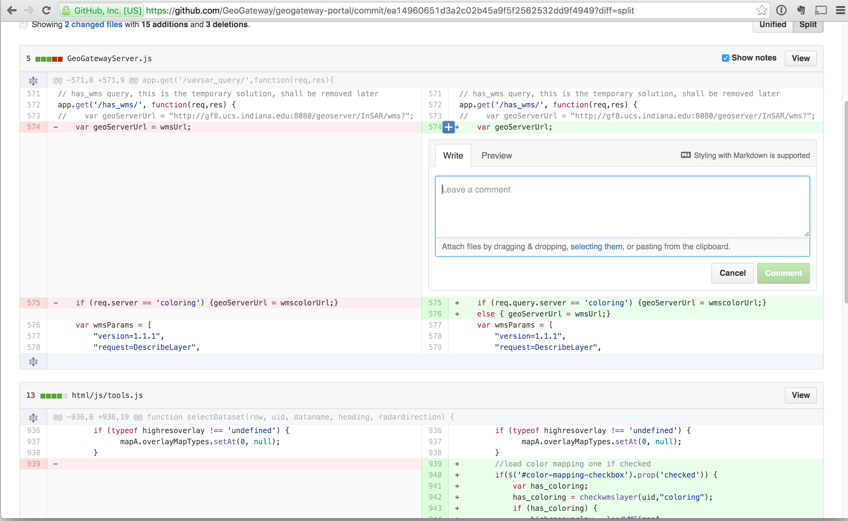
Code Review

Slide 17
Code Release Process
Choose a Release Manager.
Discuss using Issues
The Release Manager creates the Project Milestone N branch from Develop branch.
Everyone votes on the release.
+1 for working, -1 for not working
Fix bugs directly in the release branch
Release Manager manages these pull requests
Release Manager also merges the Release branch with Develop

Slide 18
Using GitHub Wikis for Documentation
Good code documents itself, but…
https://guides.github.com/features/wikis/
Use these to describe your project.
Minimally, anything the instructors need to know to check your milestones.
Each project milestone has a Wiki entry that includes all instructions on how to build and test the assignment.
Your grader will only look at the wiki.
Graders will not spend time trying to understand your setup.
Make your grader’s life easy. Happy graders are your friends.

Slide 19
Make GitHub Announcement
Announce your project milestones after they are approved by the grader.
https://guides.github.com/activities/citable-code/
This gives you a Document Object Identifier (DOI)
Useful for citing code
“This result was produced by this specific version of our code”

Slide 20
Summary
Divide up the work on your team, discuss and record using Issues.
Choose a Release Manager
Create Develop, Project Milestone 1 branches; Master already exists.
Work on your issues
Make pull request; Associate these with Issues
Another team member merges the request
When ready to release, Release Manager creates the Release Branch from Develop.
Document the release using GitHub’s Wiki for the grader.
Everyone reviews the release, votes using Issue
Everyone submits the assignment using Canvas
After grading completed, use GitHub Announce and then merge the Release branch to Master

Slide 21
Some “Apache Way” Lessons
Community over code.
Discuss issues publically in an archived, citable manner.
Assign yourself to issues.
Volunteer
Cite the issue(s) associated with each commit.
Review pull requests for code bases you can’t write to
Patches -> Apache
Call votes on important decisions
Team policies with git branches, code review, issue organization, agile policies
Software releases
Granting write access to important branches.
Make and announce your source code releases.
And be prepared for what happens next
Documentation, build systems, bug handling, code licensing, code attributions, …

